Slide 1
WPCM Overview

Slide 2
Brief history
Originally was called “Electronic Product Lineup Manager” (EPLM)
Used to create product pages for the public web site
1.x versions used ExtJS for the front end interface
  Did not follow any design standards from front end team
Back end used DWR framework
Page preview used local .jsp files to create preview
  Changes to PWS styles would not be reflected in the EPLM preview without additional changes to the EPLM .jsp files
Eventually supported both US/CA and EU pages
Eventually supported publishing pages and resources through the application
  Prior to this, publishing product pages was the bulk of Jamie’s day

Slide 3
Current state
Application was rewritten in Spring, was renamed to “Web Product Catalog Manager” (WPCM)
Uses the PWS API and server for displaying previews
Uses Thymeleaf templates and RESTful interface for managing product pages
Simplified front/back end code
  Little to no internal support for ExtJS and DWR

Slide 4
How does it work
Three components
Front end interface
  Supports product page creation, clone, editing and moving through process workflow
Preview service
  Uses the PWS styles to present the product page as it would appear on the public web site
Publishing service
  Supports publishing pages to the public web site, calling database functions and synchronizing files

Slide 5
Front end interface
Consists of two views
  Product List
    Used for searching for product pages
    Can move pages through the workflow directly from the overview
  Detail
    Used for editing a product page and moving through the workflow
    Also has a read-only view once pages have been submitted for approval

Slide 6
Product List
Provides a paginated list of product pages
Allows for search/filter by:
  Product name
  Status
  Location
  Drilldown (Clinical specialty, Product type, Clinical divisions)
Create a new product page
Minor updates to product pages
  Update status
  Duplicate product page
  Delete product page (previously published pages cannot be deleted)

Slide 7
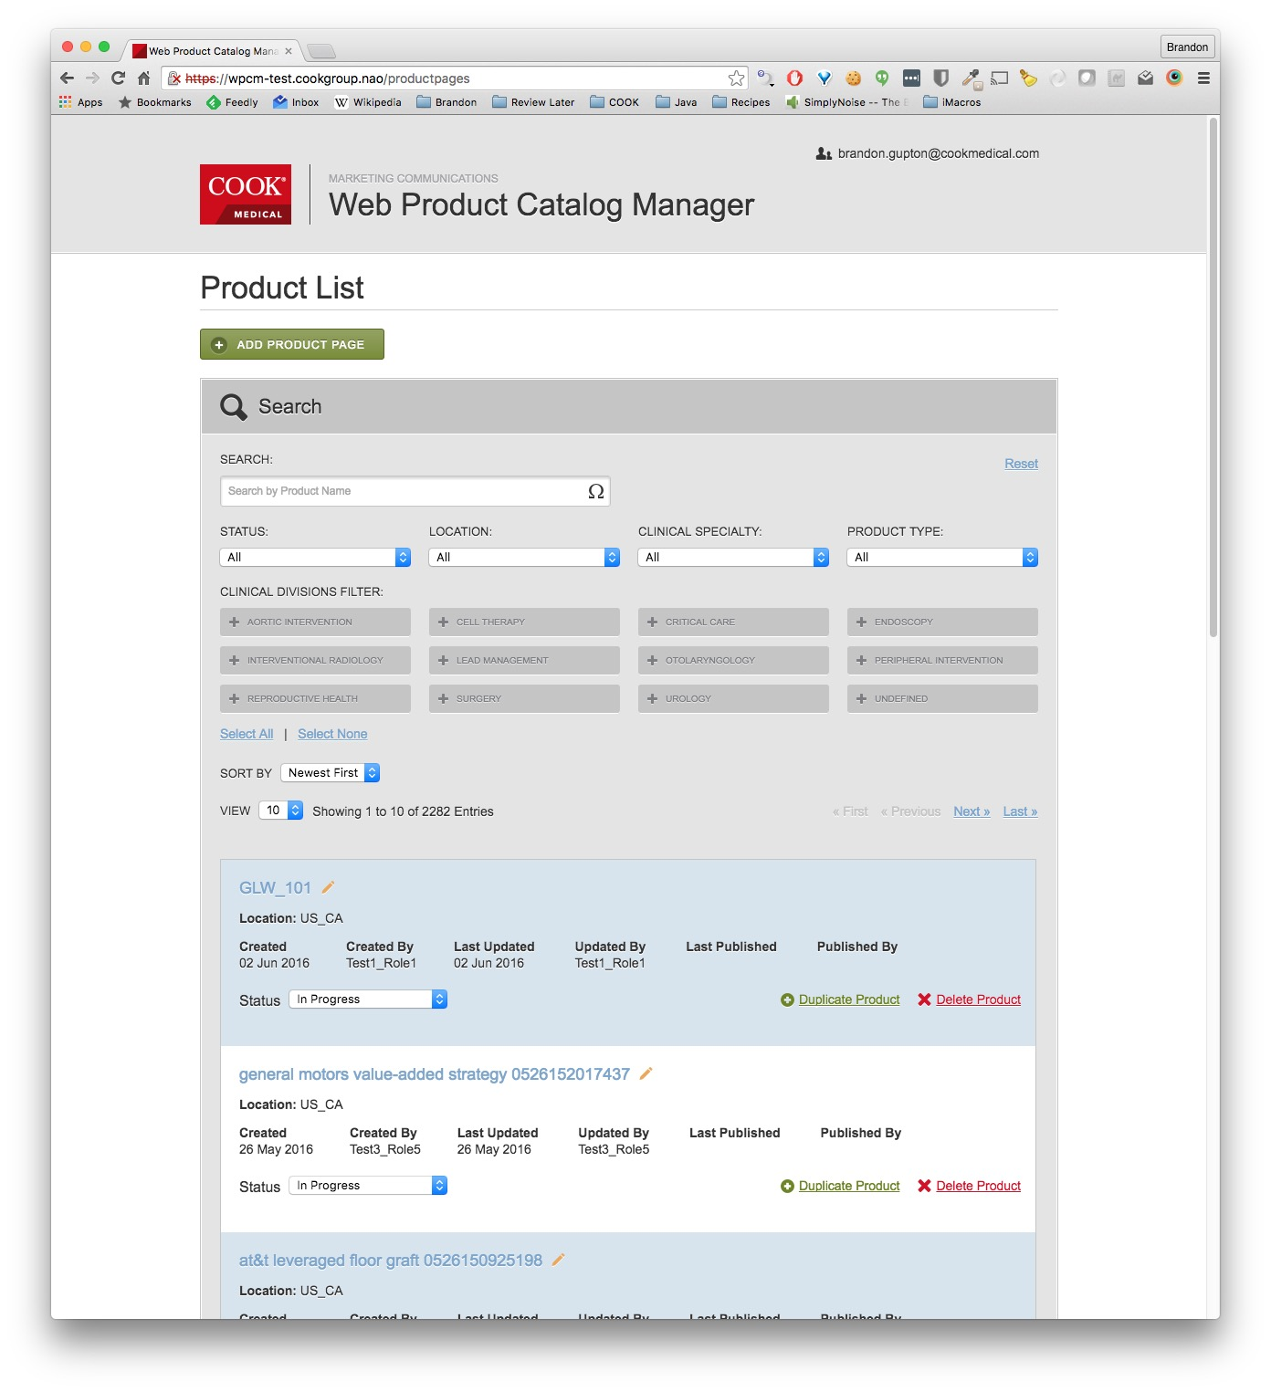

Slide 8
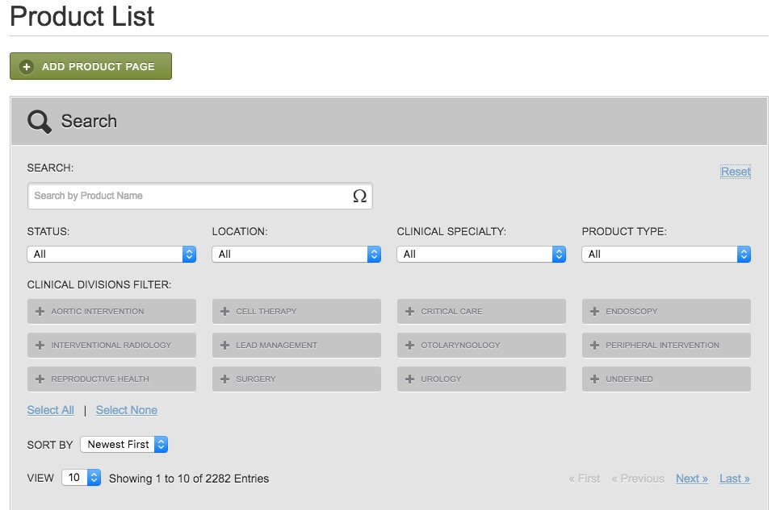

Slide 9
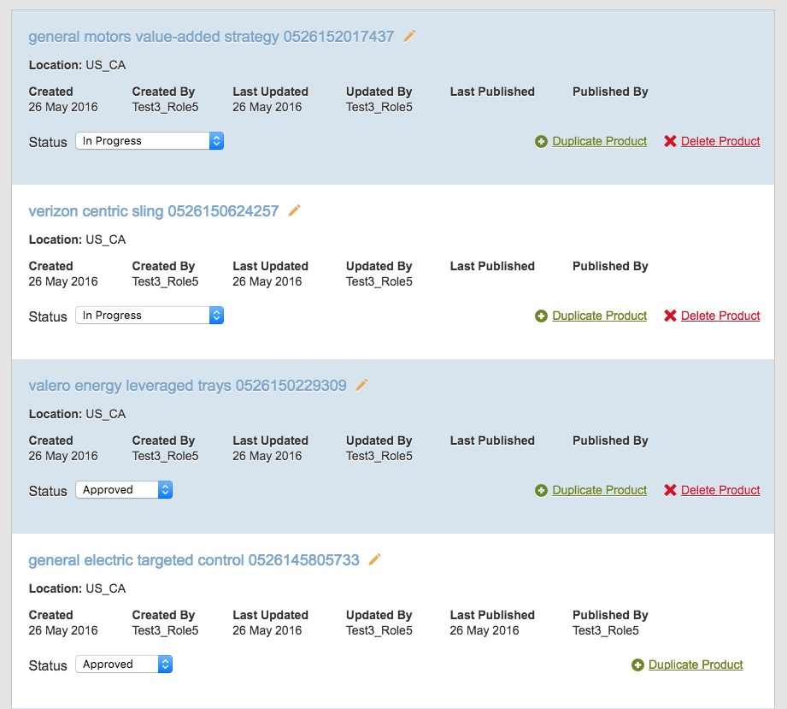

Slide 10
Edit Product Page
Consists of four (now three) sections
  General Product Information
  Specifications
  MR Information (being removed for WPCM 2.1)
  Resources

Slide 11
General Product Information
Product Name
  Consists of Brand, Brand Modifier, Modifier and Descriptor
Intended Use
  Some product pages may not have an Intended Use. A checkbox is provided to override the Intended Use validation.
  Allows for rich text entry using TinyMCE.
Product Categories (drilldowns)
  Indicates how the product page can be located on the public web site

Slide 12
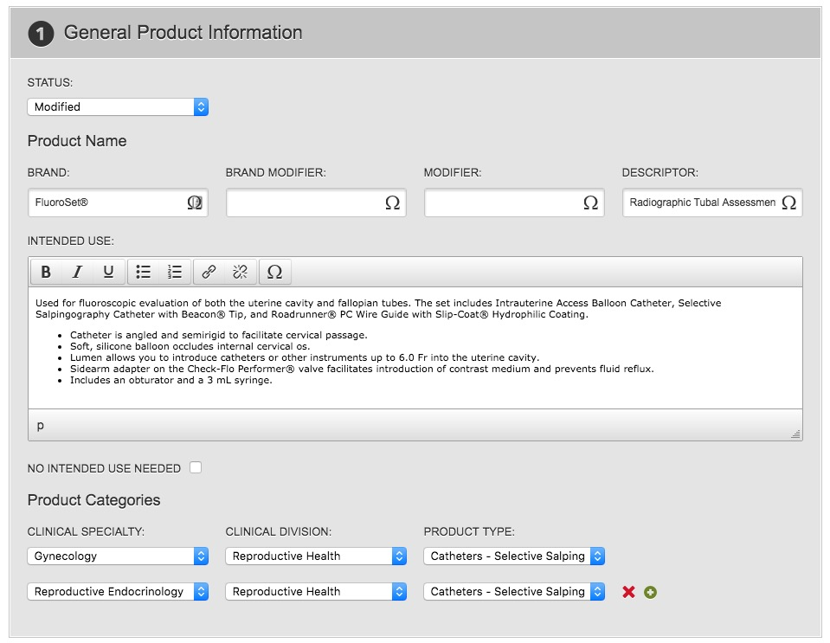

Slide 13
Specifications
Product Information
List of products, can be grouped under sub-headings
Each product can be added by GPN or RPN, or bulk add by PLC
Each product can have up to five specifications, shared spec headers for all products
Each product can have its own Component List
  Each component consists of GPN (optional), description and quantity
  Each component list has an optional footnote
There is an optional footnote for Specifications
  Footnotes also use TinyMCE

Slide 14
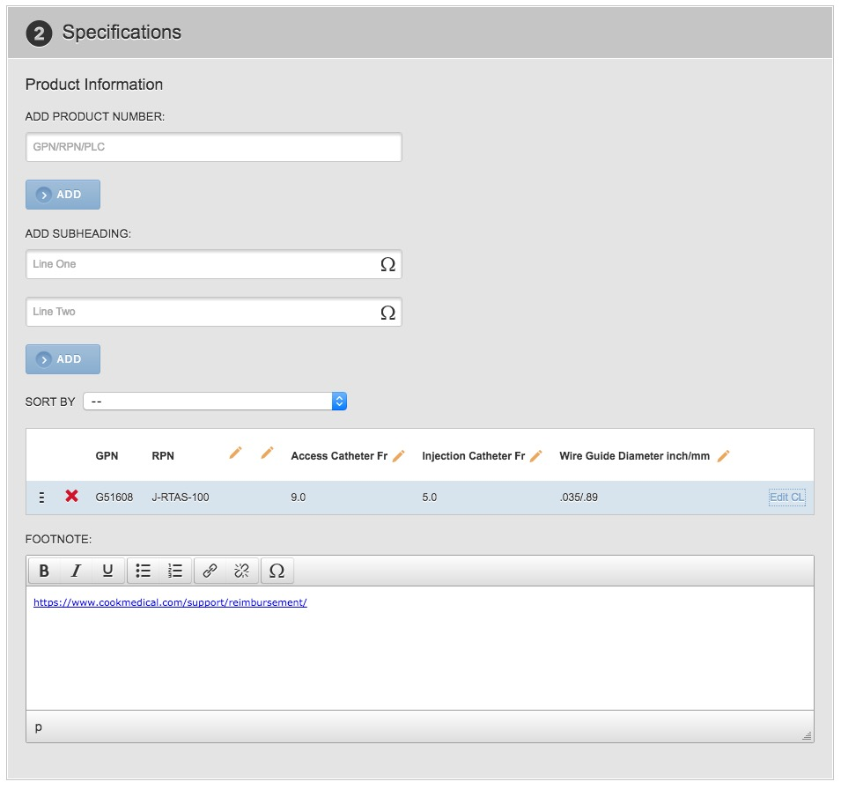

Slide 15
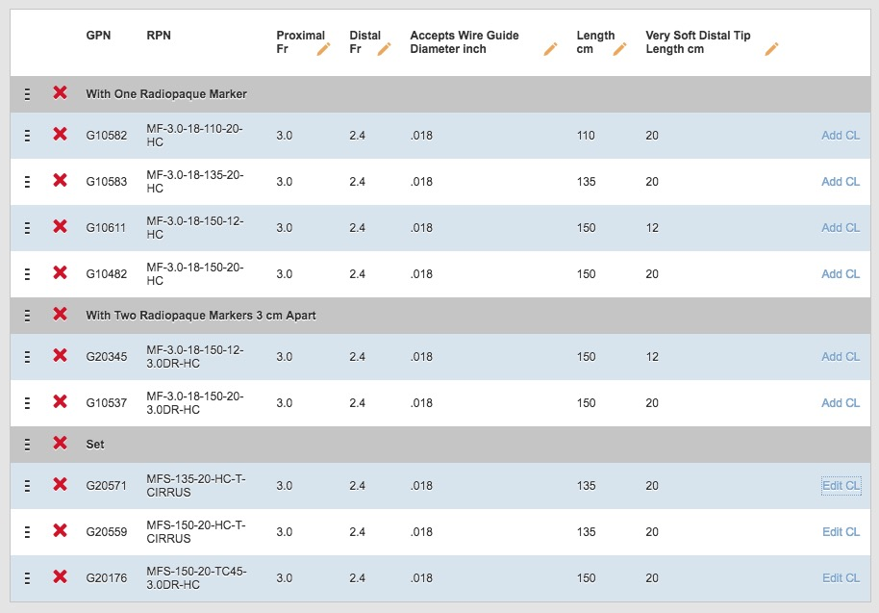

Slide 16
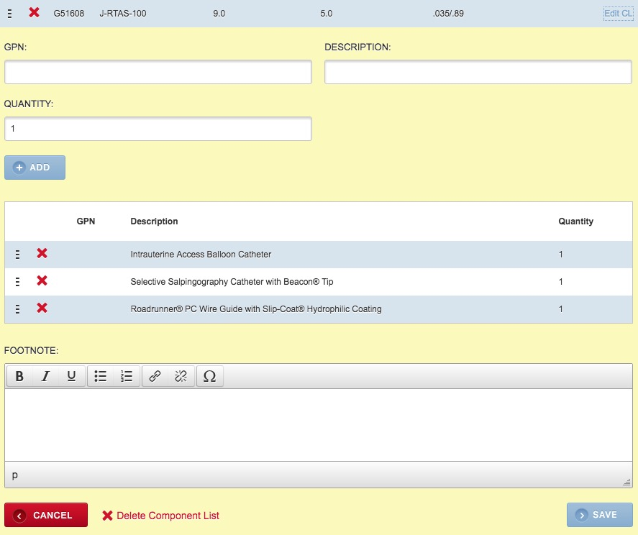

Slide 17
MR Information
This section is being removed as part of WPCM 2.1
Originally required an MR Statement if the overall status was MR Conditional
MR status will now be pulled automatically per product from GPF data, and the appropriate MR status symbol will be shown on the product page for each individual product on the page.

Slide 18
Resources
Allows users to publish resources associated with products that have been added in Specifications
Filter for available resources
  Filter asset title, media type, file type and/or category
Includes basic information about the resource
  Name, file location, ART code, media type and file type
Available Resources can be added, and Used Resources can be removed
Resources are auto-sorted alphabetically and by media type

Slide 19
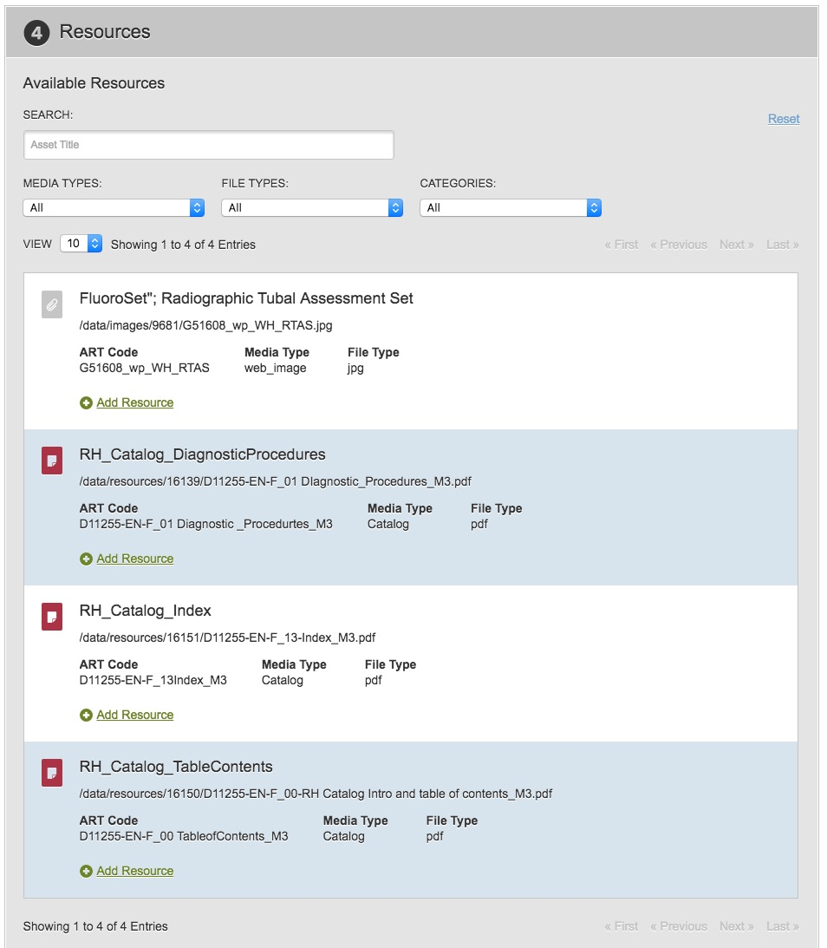

Slide 20
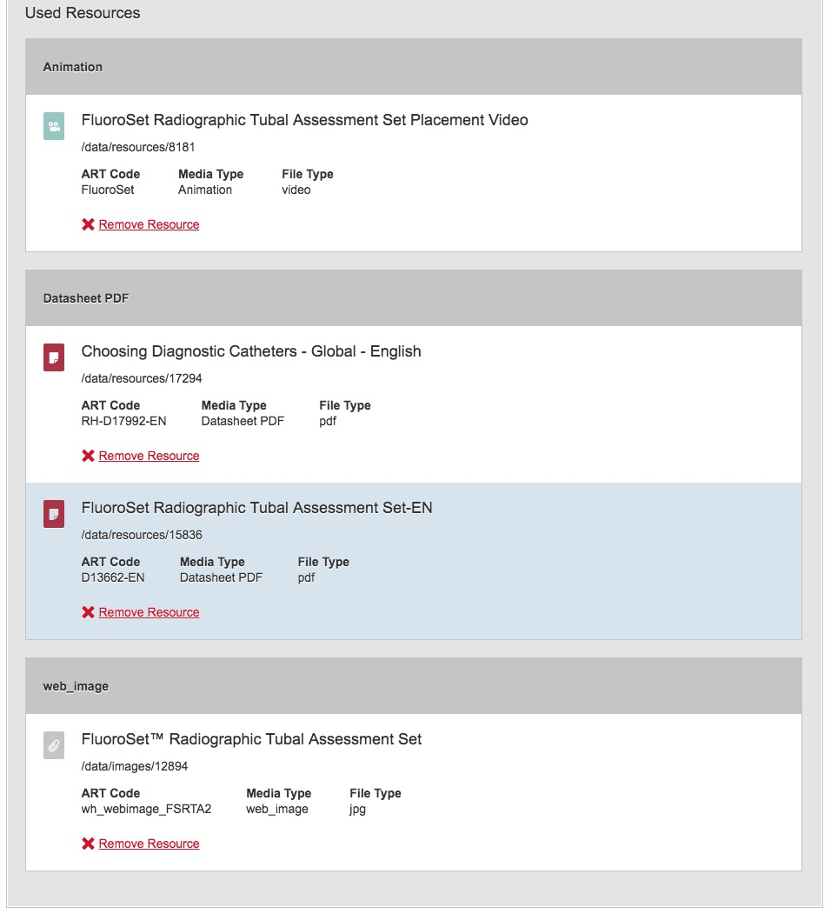

Slide 21
Preview Service
After a product page has been saved, it is available for preview
When a user previews a page, the following occurs:
  A database function is run to generate the preview xml
  The xml is posted to the PWS API to convert from xml to json
  The returned json is posted to a PWS endpoint to render the product page using the PWS styles
This prevents WPCM from needing intimate knowledge of PWS structure/styles

Slide 22
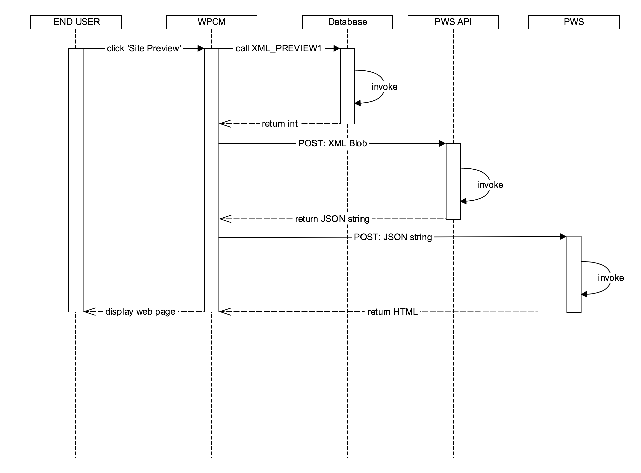

Slide 23
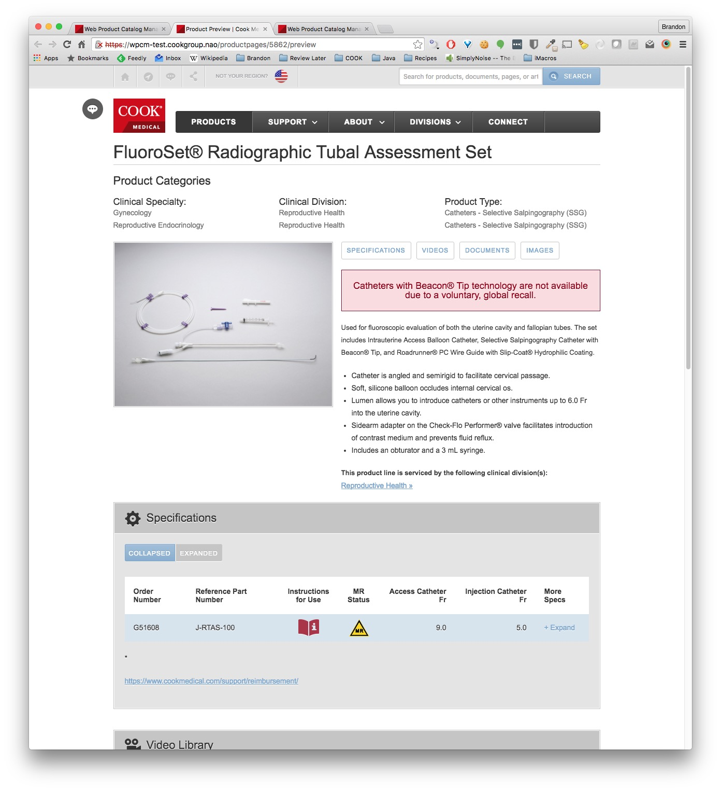
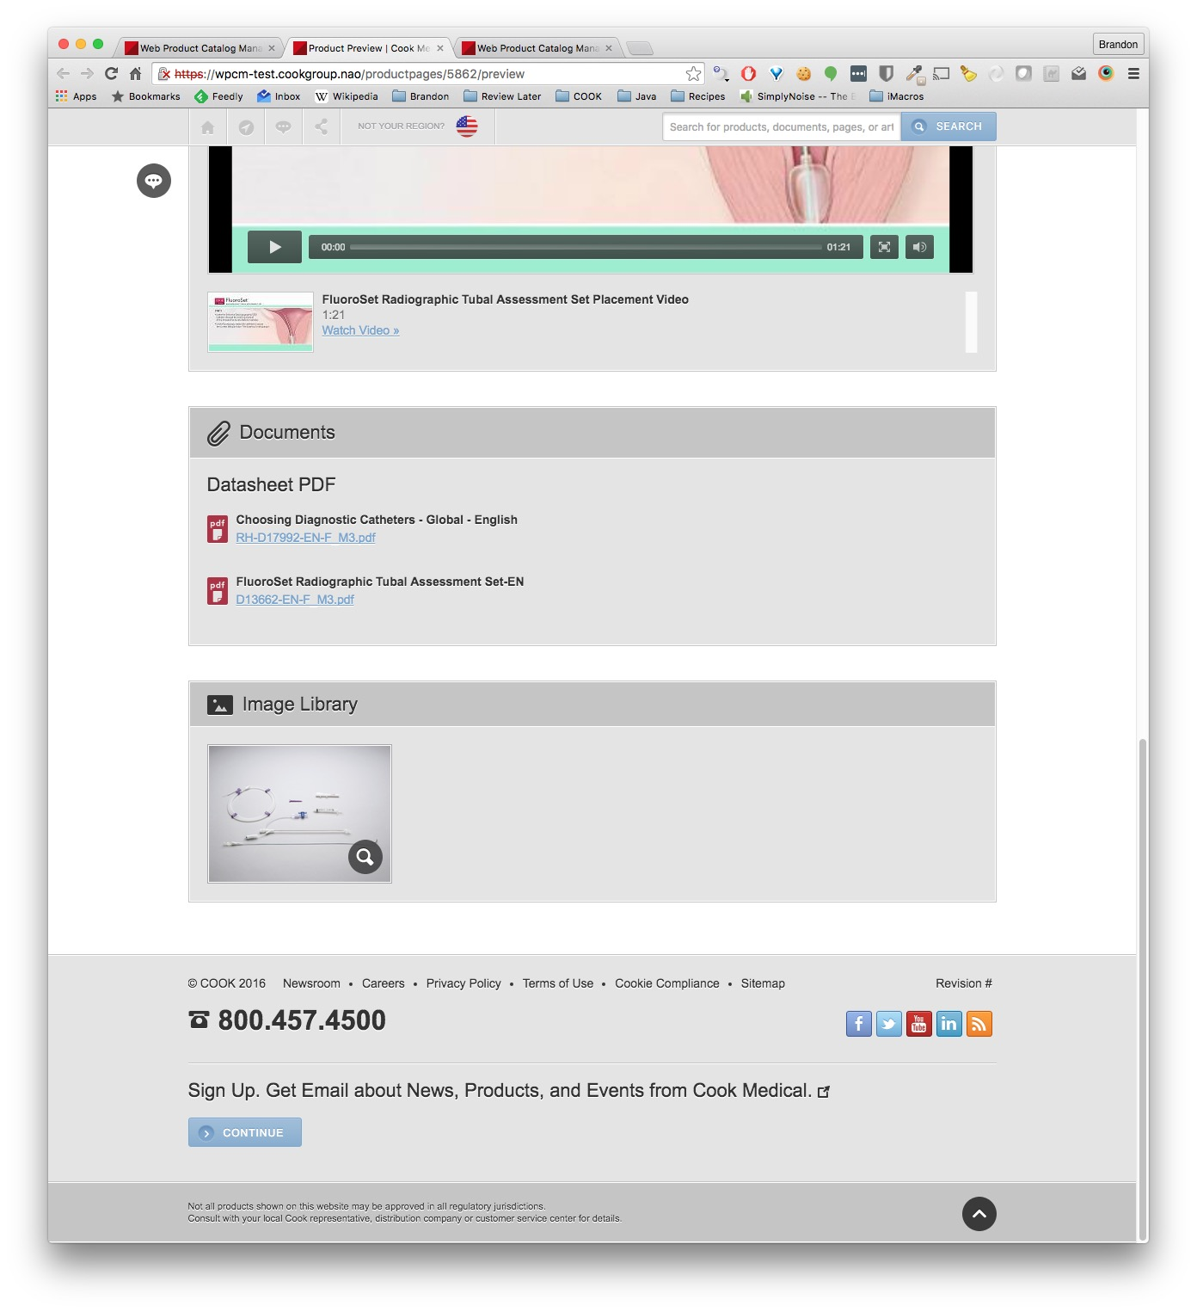

Slide 24
Publishing Service
When an authorized user Publishes a product page
  A call to the database function MOVE_TO_PUB is made
  Any resources used by the product page are published
  Another call is made to the database function AUTO_UPDATE
The database is responsible for generating the XML and sending it to the DMZ database used by the PWS
The resources are rsynced to a specific folder on the PWS server
  Resources are only added, never removed when publishing

