Slide 1

Web Product Catalog Manager
User Training
September 2015

Slide 2

Agenda
Topics
  Introduction
  Web site components
  Data systems
  Permissions
  Status types
  Business process
  Training + support
  User experience
  Features
  Demo
  Questions + discussion

Slide 3
Web Product Catalog Manager
US/CA
WPCM
EU
Notes:
Live System
US and Canada pages same as today
EU pages will post to the EU website

Slide 4
What does the Web Product Catalog Manager do?
ASSEMBLY
PRODUCT SPECIFICATION MAINTENANCE

Slide 5
What SHOULD the Web Product Catalog Manager do?
ASSEMBLY

Slide 6


The dream
Single global master file for each product
Country specific product information
Visibility online managed through global restrictions
Remove the maintenance function by linking to source systems

Slide 7
Web site content areas
PRODUCT
DIVISION
CORPORATE
SBUs
Corporate
Corporate
SBUs
Corporate
Notes:
Product
Content owned by SBUs
Division
Content owned by SBUs
Corporate
Content owned by Corporate team

Slide 8
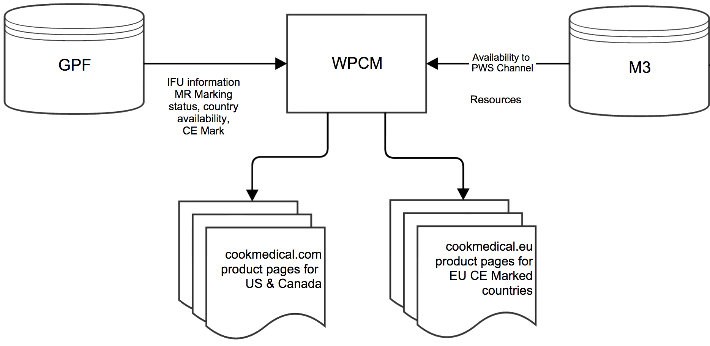
Data Systems
Data transfer relationship involved in the creation of a product page.
The diagram below depicts the GPF, M3, and WPCM. The output is either a product page for US & Canada or a CE Marked* EU product page.
* 30 countries
Notes:
When you add products to the product panel:
The IFU information and MR Marking status, country availability, and CE Mark verification for each product is pulled from GPF.
Available resources are pulled from M3 for possible inclusion on the page.
When published, the WPCM information is accessible to the products section of the site.
For US/CAN pages, those will appear on the current .com site. EU pages will appear on .eu site.

Slide 9
Features
US & Canada product pages
  Products = Yes in GPF under Country
  Regulatory Approvals for US or Canada
  Publishes to cookmedical.com
EU CE Marked product pages
  Products CE Mark = Yes in GPF
  Publishes to cookmedical.eu
Resources in M3
  GPNs associated
  Start date; end/archival date blank or future
  Security level = Public
  For distribution in at least 1 of 30 countries
  Asset marked approved
Austria | Liechtenstein
Belgium | Lithuania
Bulgaria | Luxembourg
Cyprus | Malta
Czech Republic | Netherlands
Denmark | Norway
Estonia | Poland
Finland | Portugal
Germany | Romania
Greece | Slovakia
Hungary | Spain
Iceland | Sweden
Ireland | Switzerland
Italy | Turkey
Latvia | United Kingdom

Slide 10

Permissions
There are three user permissions. The differences between them directly
relate to the statuses available to them in the system. Users can be assigned to one or more permissions.
Permission | System Actions
Edit | Create (new or clone existing) Edit Retire (if previously published) Delete (if never published) Submit for Approval View preview
Approve | View preview Change status to Approved
Publish | View preview Publish product page to PWS Retire (if previously published)
  Note: users in CAS can access Site Preview links even if not assigned WPCM permissions
Notes:
Business process discussion needed regarding permissions

Slide 11
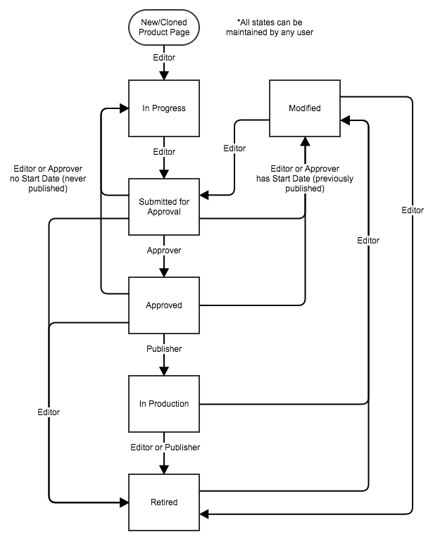
Status types
The following statuses are available to product pages in WPCM. Users can make edits while in two statuses*; others are read only.
In Progress* – new page; draft in process.
Submitted for Approval – draft completed;
en route somewhere outside of the application
Approved – through routing process (business
& functional, if needed); ready to publish
In Production – page is live
Retired – page was live at one point but now removed from PWS
Modified* – similar to In Progress but page
was live previously; brought back into the workflow for updates.
Notes:
Statuses
user only sees statuses to which they have permission to update
workflow set so product page can flow through system as intended
While editing a product page, the statuses available will be enforced based on the intended status flow and permissions assigned.
* Changing the status of the page from the search screen will still prompt the user to confirm the status change. When selecting the status of 'In Production' from the search screen, the user will be asked to confirm the publish of the product page.
A status change from the edit screen is a two step process now where the user will select the new status then click SAVE to save the changes. When selecting the status of 'In Production' from the edit screen will prompt the user with an informational message that saving this page with a status of 'In Production' will publish this product page to the Public Web Site.

Slide 12

Business process: Permissions* + (Status)
Edit
  Data manager creates (In Progress) & edits (Modified)
  Prepares to route (Submitted for Approval)
  Retires (Retired)
Approve
  Marketing manager approves (Approved)
Publish
  Fulfillment publishes (In Production)
  Approval retention according to Retention Policy
* All permissions can view the site preview.

Slide 13

Training + Support
User guide, release notes & supplemental docs
  https://apphelp.cookmedical.com
CourseMill
  Available through Cook Learn
User Permissions
  Requests sent to DeLaina, who will work with IT
Global IT Support Services
  Provide first tier support & troubleshooting
  Escalate issues to project team for resolution, if needed
    North America: it.support.nam@cookmedical.com | 1-866-920-6508
    Europe: it.support.emea@cookmedical.com | +353-6123-9477
    Asia/Pacific: it.support.apac@cookmedical.com | +617-3434-6006

Slide 14

User experience
Browser support
  IE 11 (PC)
  Safari 9, 10(Mac)
  Compatibility mode
  set to ‘Off’ in IE
Sessions
  Prompted with timeout message if inactivity
  Click Login to reauthenicate session
  Close browser to end session
  Encouraged to save often
Notes:
Contact IT Support if you need assistance to update browser.
The latest Chrome browser is supported, but has not been tested.

Slide 15

Features: Required fields
  Required for save
  Descriptor
  Required for status change
  to "Submitted for Approval", "Approved",
  and "In Production”
    Clinical Division, Clinical Specialty, Product Type
    At least one product
    Either intended use statement included or checkbox selected for "No Intended Use Needed”

Slide 16

Features: Duplicate + Product Availability
  Duplicate a product page
  Removes all selected products & resources from the new product page that are not available for the selected location
  Message displayed to this effect
  Verify availability of products associated
  System verifies included products are still available
  when a user attempts:
  to save the product page in an "In Progress" or "Modified” status
  to change status to "Submitted for Approval," "Approved," or "In Production"
  Message of which GPNs are no longer available if save or status change fails

Slide 17

Features: Intended Use
Products with no intended use
  Indicate if a product does not have an intended use to display by checking the "No Intended Use Needed” box.
  Disable/enable Intended Use Statement field when the check box is selected/cleared. Content of Intended Use Statement field is retained.
  If user attempts to set the status to "Submitted for Approval", "Approved" or "In Production", and the Intended Use Statement field is not empty and the check box is selected, the system shall display a message.
Notes:
Descriptor still required for save!!!!
Box defaults to unselected
Message displayed:
You have indicated that the Intended Use Statement is NOT required. Any text entered into the Intended Use Statement box will not be published to the public web site when the status of this EPL is set to In Production.

Slide 18

Features: Site Preview
  users in CAS can preview pages even if no other WPCM permissions
  If user prints from the preview, it will print in the expanded printable view.
  connected to PWS code so updates there are reflected in WPCM
Notes:
Site Preview
Users are still able to preview the product page using the Site Preview link. This site preview is now connected to the website so that changes made to the website display will also be reflected in the Site Preview in WPCM. The Site Preview URL is different now, so users may need to update any bookmarks to specific page previews.
The extra 'Printable' button was removed, but the functionality is still contained within the application. Historically, there was a Printable button to display the product page with an expanded view of the content (accordions open, stacked tabs, etc). In this new version and going forward in the application, if a user chooses to print the Site Preview from the browser, the system will automatically create the printable view with the product information presented in a way that can be printed and routed for approval.
Another important enhancement to the Site Preview was to open the preview capabilities to other users. Just because a user doesn't have permission assigned to access WPCM doesn't mean he or she cannot see the Site Preview of the product page before it is published. If a user creates a page in WPCM, the url for that Site Preview can be emailed to others for feedback before approving or publishing the page to the website. As long as users can sign in to applications through our CAS system, they should be able to view the Site Preview at any time.

Slide 19
FAQs + Known Issues
Subheadings – inability to edit
Unavailable resources – not automatically removed from PWS; must republish page through WPCM
Site Preview – not available for Retired pages; unavailable products still appear here if not yet removed from WPCM page
Browser support – IE 11 & Safari 8, 9; Compatibility mode “OFF” in IE
Copy/Paste – make sure to paste into plain text editor first to remove any additional formatting that could be copied into WPCM inadvertently
No sign-out – Connected to CAS, so direct logout would disable form others apps connecting to CAS in the session
Error on Publish – sometimes an error occurs when trying to publish. Notify Support Services with the following info to create ticket: product name, location, and ID. Support will assign to Tier 2 support to investigate.

Slide 20
Thank you for your time and attention! Any questions?

Slide 22
  Enhancements + Bug Fixes – versions 2.1 + 2.2
  Resources
  now displays asset languages (assigned to the asset in M3)
  updates to the interface & data for new asset type & asset subtype structure (M3 3.1)
  delete an asset from the PWS file system when it is no longer attached to any published product pages
  Search
  visual indicator added near product page status to indicate that a background action is in process
  MRI Information
  remove MRI Information section from WPCM including validation for MR Conditional statement
  MR Mark (Safe, Unsafe, Conditional pulled from GPF per product)
  MR Conditional statement with a hover message of Refer to IFU
  Bug Fixes
  backend updates to address log files & audit trails
  front end updates to correct some error messages in interface

Slide 23
  Enhancements 2.0
  Design
  new design based on UI toolkit
  rearranged to match PWS tab layout
  additional icons introduced
  Site Preview
  connected to PWS code so updates there are reflected in WPCM
  users in CAS can preview pages even if no other WPCM permissions
  If user prints from the preview, it will print in the expanded printable view.
  Resources
  Click to add/remove
  Statuses
  user only sees statuses to which they have permission to update
  workflow set so product page can flow through system as intended
  Search
  product name search filters as you type
  other choices filter as you go
Notes:
The functionality is generally the same with a few enhancements and bug fixes addressed.
Resources
The design and layout for this section saw many enhancements in this version. Instead of side by side areas for the available resources and resources in use sections, these areas are stacked with Available Resources area atop the Used Resources area. Each area was expanded to allow for better visibility of the resource metadata as well as prepare for future enhancement requests for the application to show more metadata and thumbnails per resource.
Click 'Add Resource' or 'Remove Resource' links to move each resource back and forth between the the Available Resources and Used Resources areas. If a resource was previously attached to a product page (moved to the ‘Used Resources’ area) and it is no longer available to be displayed on the website, the system will visually indicate when the resource in use is no longer available, and users will need to remove the resource from the page to continue.
Special Characters
Special characters are coded in a more standardized way in this version using UTF-8 encoding that will allow expansion when other languages and special characters are needed for the website product pages. Users will see the Ω (omega) symbol as the special character indictor in more places within the application, and this selection can be utilized as users type text within certain fields. While this special character selector is not present in each cell of the specifications table, users can still copy and paste these characters into each specification cell, and in cases where the character may not be entered into the appropriate location within the text, users can cut and paste these symbols appropriately.
Search
There were search enhancements for this release to include more of a filter capacity. Users will notice the search results narrowing as they type product names within the search field. The filters are cumulative, so choosing a combination of search criteria will continue to narrow the returned results. There is also a progress indicator in the upper-right hand corner of the search area to show when a search is in process. Enhancing the search capabilities for this release also helped to solve some of the unexpected search results sometimes encountered in previous versions.

